Slide 1

Lead Scoring Case Study
-Ishan Singh Rawat
DSC-47
Assignment for upGrad & IIIT Bangalore

Slide 2
Problem Statement
X Education sells online courses to industry professionals.
The company markets its courses on several websites and gets a lot of leads, Once these leads are acquired, employees from the sales team start making calls, writing emails, etc. Through this process, some of the leads get converted while most do not. The typical lead conversion rate at X education is around 30% which is very poor.
To make this process more efficient, the company wishes to identify the most
potential leads, also known as ‘Hot Leads’.
If they successfully identify this set of leads, the lead conversion rate should go up as the sales team will now be focusing more on communicating with the potential leads rather than making calls to everyone.

Slide 3
Business Objective
X Education wants the information of the most promising leads.
The company requires a model to be built wherein a lead score is assigned to each of the leads such that the customers with higher lead score have a higher conversion chance and the customers with lower lead score have a lower conversion chance..
ballpark of the target lead conversion rate is to be around 80%. which is set
by CEO, in particular.

Slide 4
Methodology for Problem Solving
Loading Datasets
Data Understanding
Checking Structure of datasets
Checking other attributes like using info(), describe(), shape etc
Data Cleaning
Deleting all the Redundant columns and rows
Analyzing all the missing values, improper data types, duplicated rows
Imputing all the Missing values
Rectifying the improper data types
Outliers treatment
Data Analysis (EDA)
Imbalance data Analysis
Defining functions for plotting
Univariate analysis of each variable

Slide 5
Data Preparation for Model creation
Dummy Variable Creation
splitting the data into Train Test
Scaling feature
checking for correlations in data modelling
Model Evaluation
Calculating all the important metrics such as
(sensitivity, specificity, recall, precision, F1-score, etc.)
Plotting ROC curve
Plotting precision and recall trade off
Finding optimal cut off probability
Making predictions using test dataset
Final results and Summary

Slide 6
Data Cleaning :
Initial step was to find the duplicate values we found none
Next we checked for missing values in rows and kept a threshold of 35% since many columns were having more
than 40% of missing data
Columns having missing values more than 35% were dropped since imputing these columns would certainly
deprecate the data quality
data have
For columns having less than 2% missing data we have dropped the rows, after which 98% of total data was retained.
Since all the numeric columns had less than 2% data so we have handled them during the above process.
The remaining categorical columns, which had null values between 15% - 30% of missing values but also were
highly skewed data was also dropped.
Those Columns not having highly skewed data were imputed using the modal value of that column.
Columns having incorrect data type were also rectified.
values have
rows)

Slide 7
Data Analysis (EDA)
Analysis Of Imbalance for Converted Variable
Analysis Of Numerical Variables With Respect To Converted
Variable
Analysis Of Categorical Variables With Respect To Converted
Variable

Slide 8
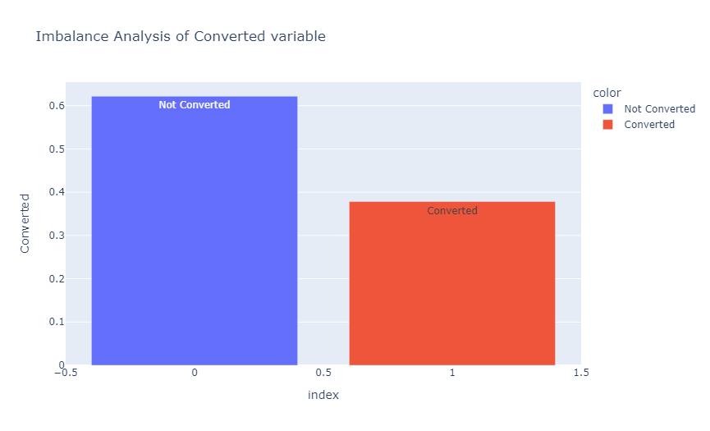
Imbalance Analysis
Only 38% Of Total Leads Have Been Converted Whereas 62% Are Not Converted

Slide 9
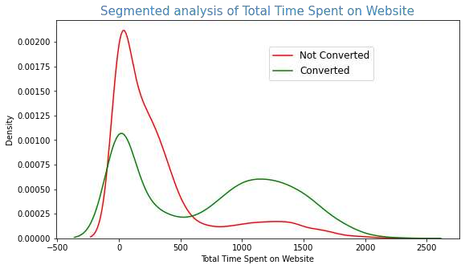
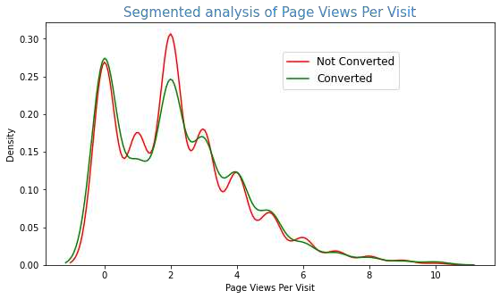
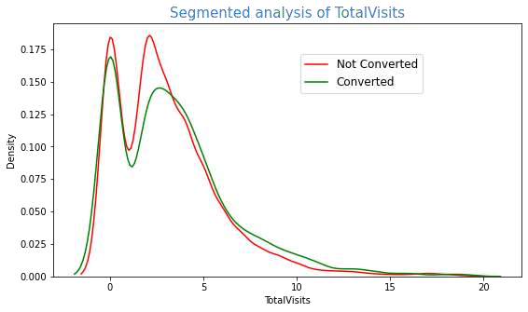
Numerical Variables
Analysis:
Those customers who spend more than 10 mins on the website are more likely to be converted leads than those who spends less than 10 mins surfing the website.
In case of other numerical features such as(`TotalVisits` and `Page Views Per Visit`), there is no proper distinction between converted and not- converted customers, but we can say that, those customers who view more pages as well as visit the website more times are likely to be converted leads

Slide 10
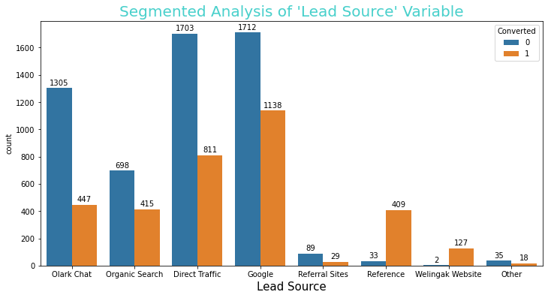
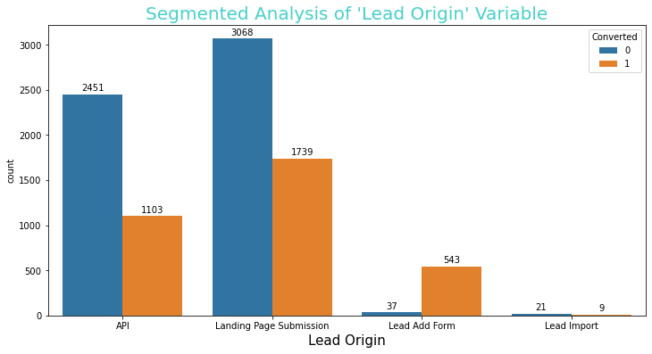
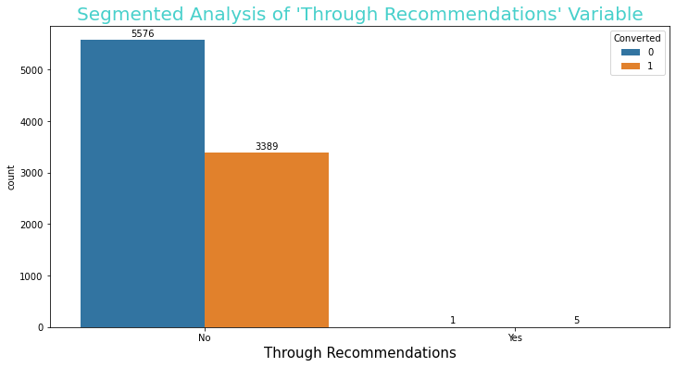
Categorical Variables
Analysis
Leads which are generated from `reference`, `Welingak Website` and `Lead Add Form Lead Origin` can be considered as hot leads as the conversion rate is more than 90%
From recommendation of other customers there is high probability of becoming converted lead of due to high conversion rate and can be termed as hot leads.
In the column of `Through Recommendations’ the `Yes` category although having less entries, have highest conversion rate,which is more than 83%

Slide 11
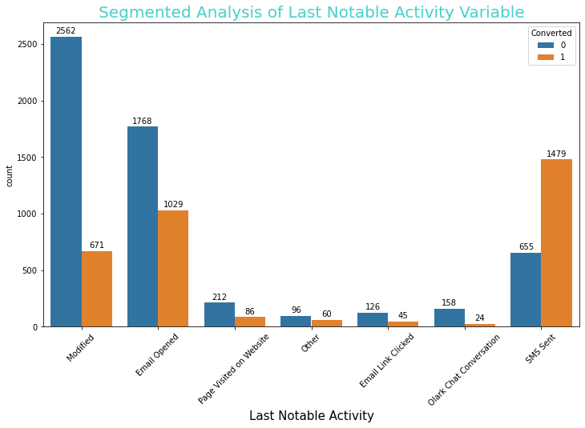
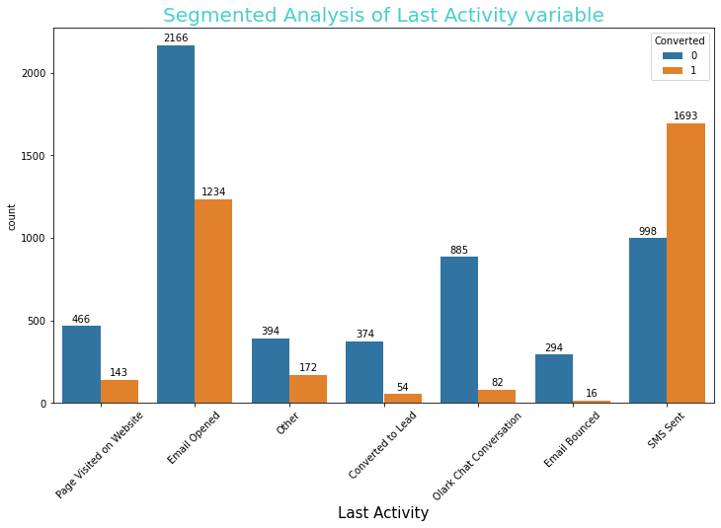
Categorical Variables
Analysis:
In column `Last Activity` , `SMS Sent` category is the one with highest conversion rate of 63%
In which categories namely `Olark Chat Conversation` and `Email Bounced` have the lowest conversion rates of 9% and 8% respectively.
In the column `Last Notable Activity` , the highest conversion rate of 70% is in category ‘ SMS Sent
The lowest conversion rate is in “Modified, and “Email opened”.

Slide 12
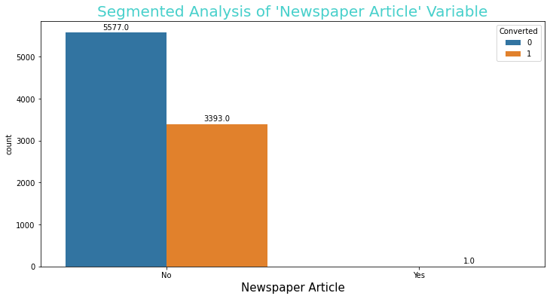
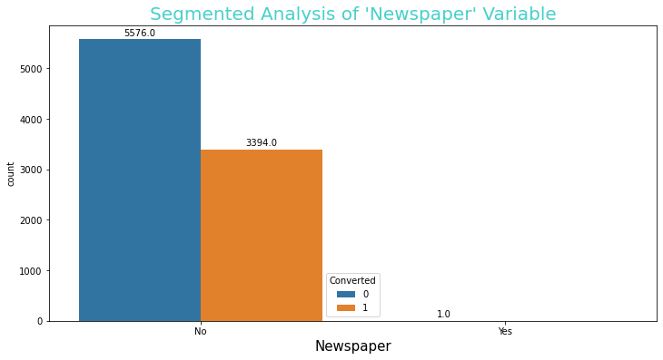
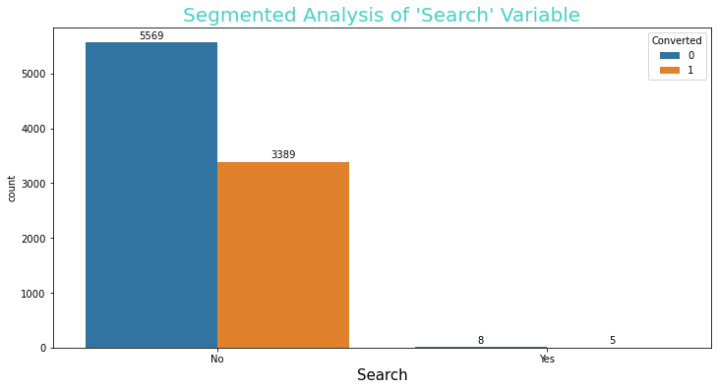
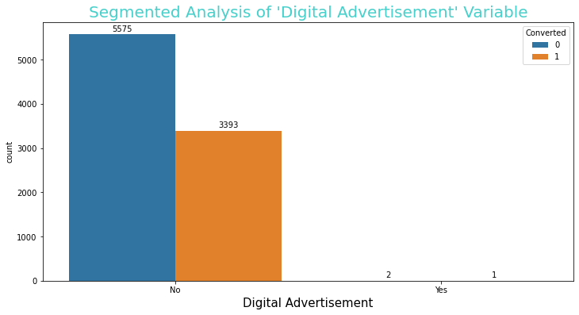
Categorical Variables
Analysis:
Around 99% of customers haven’t seen any ad through the mentioned channels
All the columns having category 'No' have around 38% of the conversion rate

Slide 13
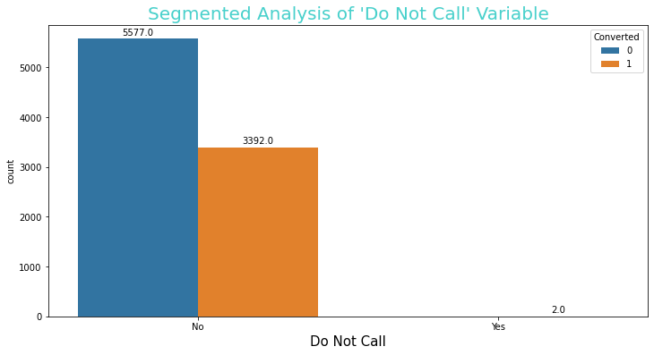
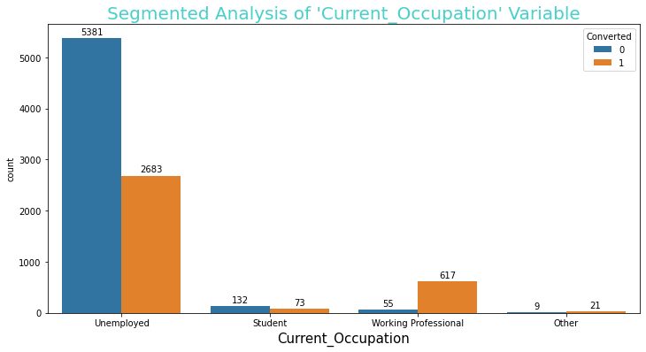
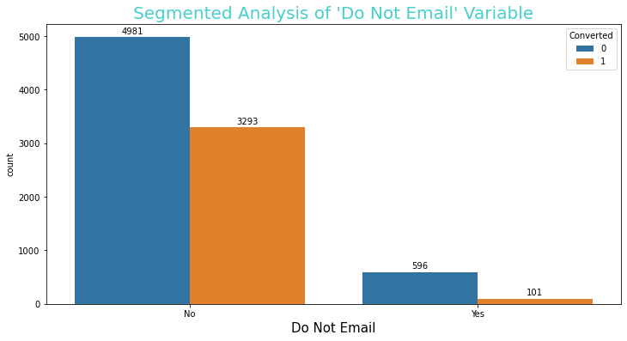
Categorical Variables
Insights
In `Do Not Email` column major conversion(about 40%) has
happened when
customer opted for it
In `Do Not call` column major conversion(about 38%) has happened when customer opted for it. Also though only 2 customers opted to not get a call but they both got converted
In `Current_Occupation` column `Working Professional` category
has the highest conversion rate, greater than 67% followed by
`Other` category having conversion rate of 60%
Working Professionals are most likely to convert

Slide 14
Variables Impacting Conversion Rate
Customer Filled Variables Which Impact Conversion Rate
Do Not Email
Totalvisits
Total Time Spent on Website
Lead Origin_lead Add Form
Lead Source_Direct Traffic
Lead Source_Google
Lead Source_Organic Search
Lead Source_Referral Sites
Lead Source_Welingak Website
Current_Occupation_Working Professional
Sales Team Generated Variables which Impact Conversion Rate
Last Activity_SMS Sent
Last Notable Activity_SMS Sent

Slide 15
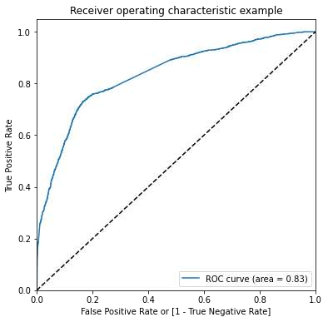
Model Evaluation on Train Dataset
ROC Curve

Slide 16
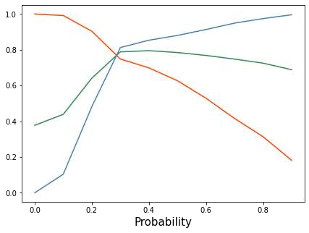
Confusion Matrixx
Sensitivity-Specificity
3176 734
596 1773
Accuracy Score of 78.8%
Specificity = 81.2%
Sensitivity = 74.8%
False Positive Rate = 18%
Positive Predictive Rate = 70.7%
Negative Predictive Rate = 84%
When using the Sensitivity-Specificity-Accuracy plot, we found the optimal cutoff point to be 0.3.

Slide 17
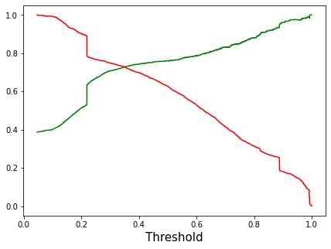

Precision-Recall Tradeoff
Confusion Matrix
3265 645
643 1727
Accuracy Score of 79.5%
Precision = 72.8%
Recall = 72%
Specificity = 83.5%
When using the Precision-Recall Tradeoff,
we found that the optimal cutoff point to be 0.35.

Slide 18
Model Evaluation On Test Dataset
Confusion Matrix
Using the sensitivity-specificity we found that the optimal cutoff point was
0.3. When we plotted the precision-recall tradeoff, we got the optimal cutoff point to be 0.35, since we pay more emphasis on sensitivity inorder to predict “hot leads” we will henceforth choose 0.3 as the final optimal cutoff point
1382 285
Accuracy Score of 80.2%
Specificity = 82.9%
Sensitivity = 75.8%
248 777
Considering the Cutoff of 0.3 we can infer that if any lead having a leads score of 30 or above then, that lead has high probability of getting converting and should be considered as a potential “hot lead”.

Slide 19
Conclusion
The conversion rate before building the machine learning model was merely 38% but post building the model we were able to predict 80% of leads which could converted making a conversion rate of about 80%, i.e. an incrementof 42%.
Any lead possesing a Lead Score which is greater than 30 should be considered as a Hot Lead
Customers who spend about 10 minutes or more on the website or have Lead Origin as 'Lead add form' should be considered as potentail hot leads since they have a high chances of getting converted.
Clients having 'Reference' or 'Wellingak Website' as Lead Source or customers who are working professional generally have a high probability of getting converted and must be considered as potential hot Leads
Customers who visit the website more often (5 times or more) have a good chance of getting
converted , we can target them inorder to increase the conversion rate

Slide 20
Recommendations
While surveying we have found that a lot of leads which are generated in the initial stage out of which very few of them come out as paying customers. In the intermediate stage, we have to cater these potential customers well (i.e via. sharing the knowledge about the product, constantly communicating etc.) which will ultimately lead us to increase the conversion rate.
Customers having a lead score of (30 or more)are more likely to join , so sales team has to be actively looking after these leads , so that we
don’t miss any potential customer.
Once all the customers having a lead_score of 30 or more have been catered, then the sales team should also consider and target
customers with lead_score of 20 and above as there is a possibility of these customers to convert too.
One strategy to minimize the rate of useless call is to pick those customers having a lead score of 60 or above, since they are most likely
to join the course, regular follow up would increase the chances of conversion .
If a customer is having a lead score lower than 60 or 70 but have a combination of attributes which are, multiple visits to website, spending more than 10 minutes of their time on the website surfing for information regarding the course, customer is a working professional or has Lead Source as ‘Welingak Website’ and has Lead Origin as ‘Lead Add Form’ or visited the site due to recommendation provided by fellow students then those customers are most likely to convert and should be our potential target.

